Slide 1


An International Period Campaign
Ghana • Jamaica • USA (2026 Launch)

Slide 2
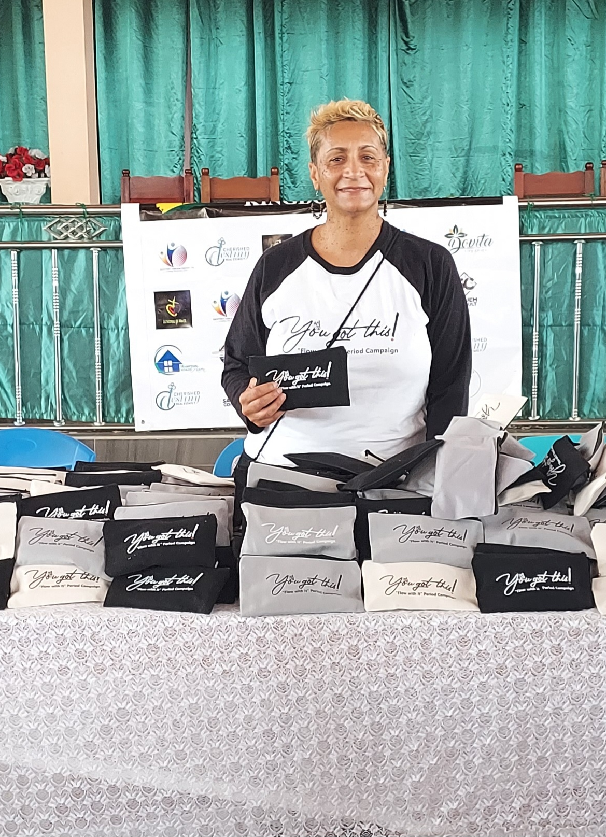
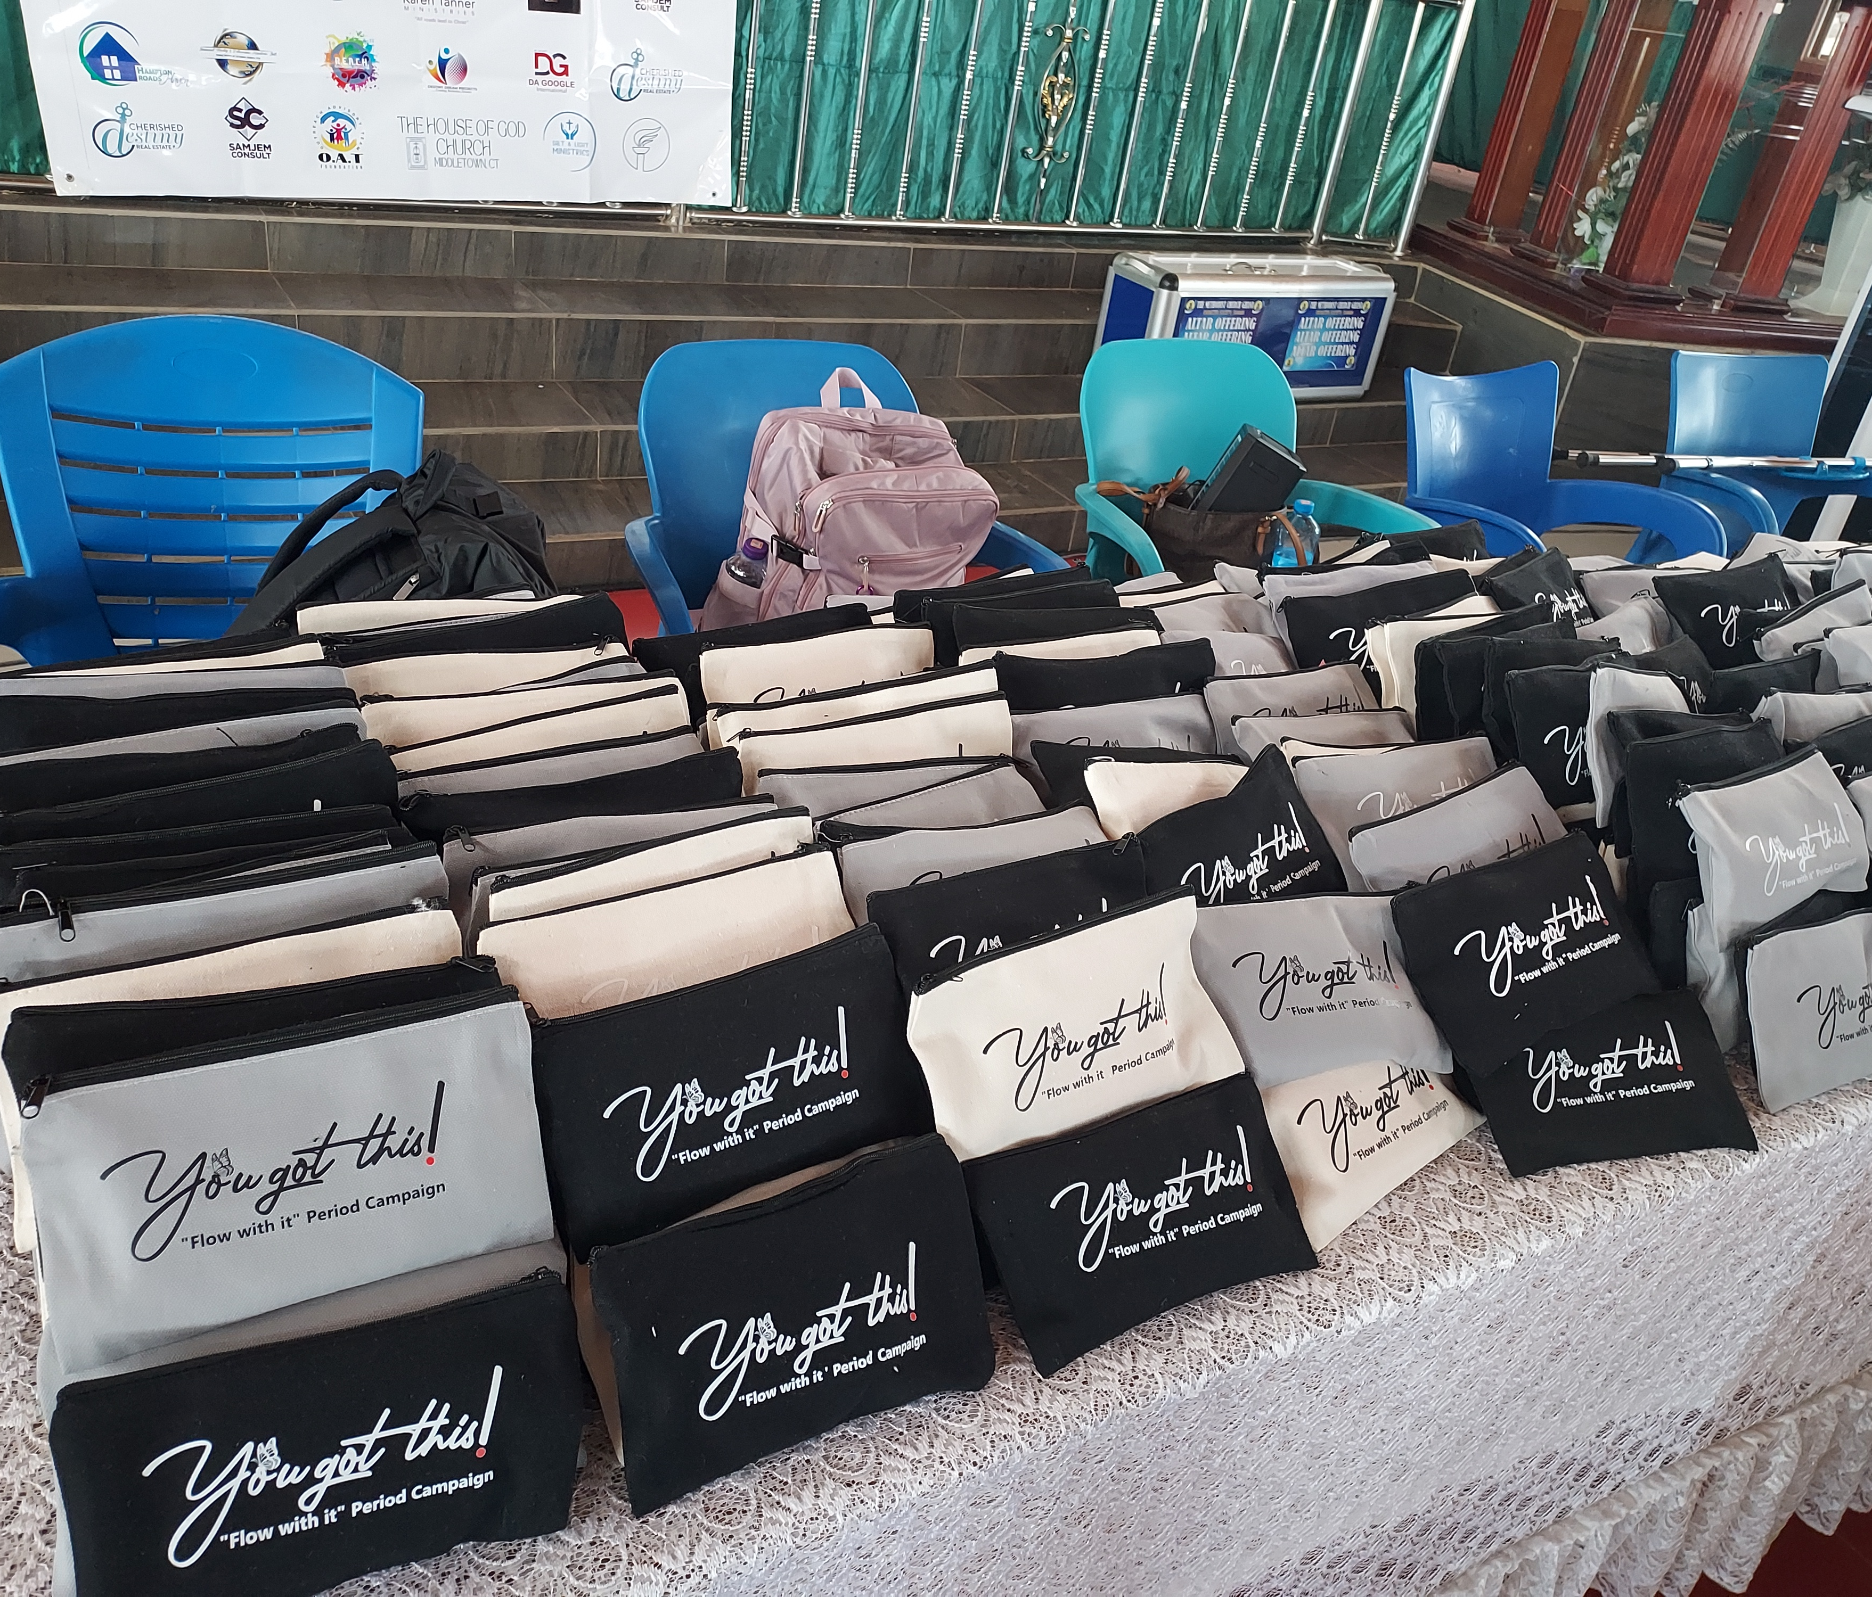
Campaign Overview
The “You Got This! Flow With It!” campaign is an international menstrual equity movement that empowers young girls and women through education, awareness, and access to menstrual products.
Launched in Ghana and Jamaica, the campaign addresses period poverty, stigma, and health education while fostering confidence and self-worth.

Slide 3
Our Mission
To empower, educate, and equip girls worldwide to manage their menstrual cycles with dignity.
We aim to:
💪 Normalize menstrual conversations
📘 Provide health education
🩸 Ensure access to menstrual products

Slide 4


Global Reach
    School visits and menstrual health workshops for young girls.
Community empowerment and hygiene education.
🌍 United States:
  Florida Private school (DeLand Preparatory School)
  Upcoming 2026 campaign launch expanding outreach and advocacy.
✨ Distribution of sanitary products
✨ School & community workshops
✨ Empowerment through education
Girls are learning to ‘Flow With It!’ — confidently and proudly.

Slide 5
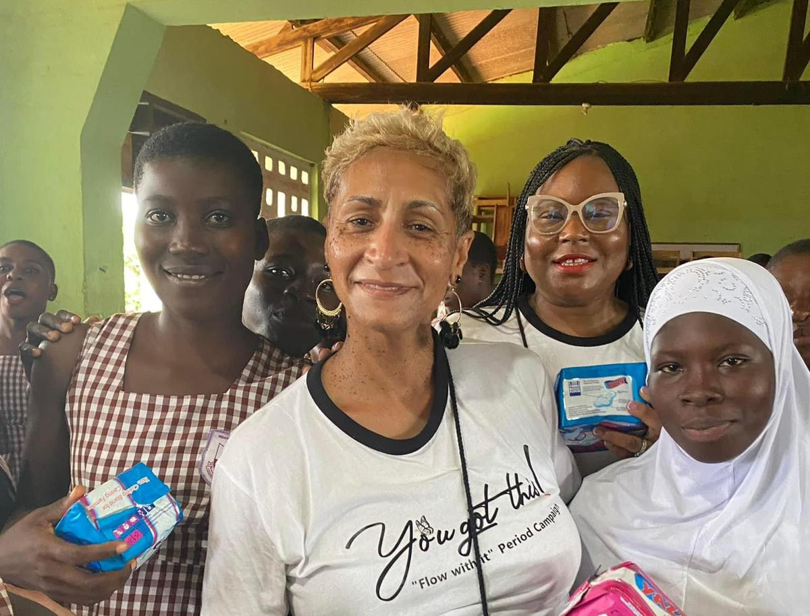
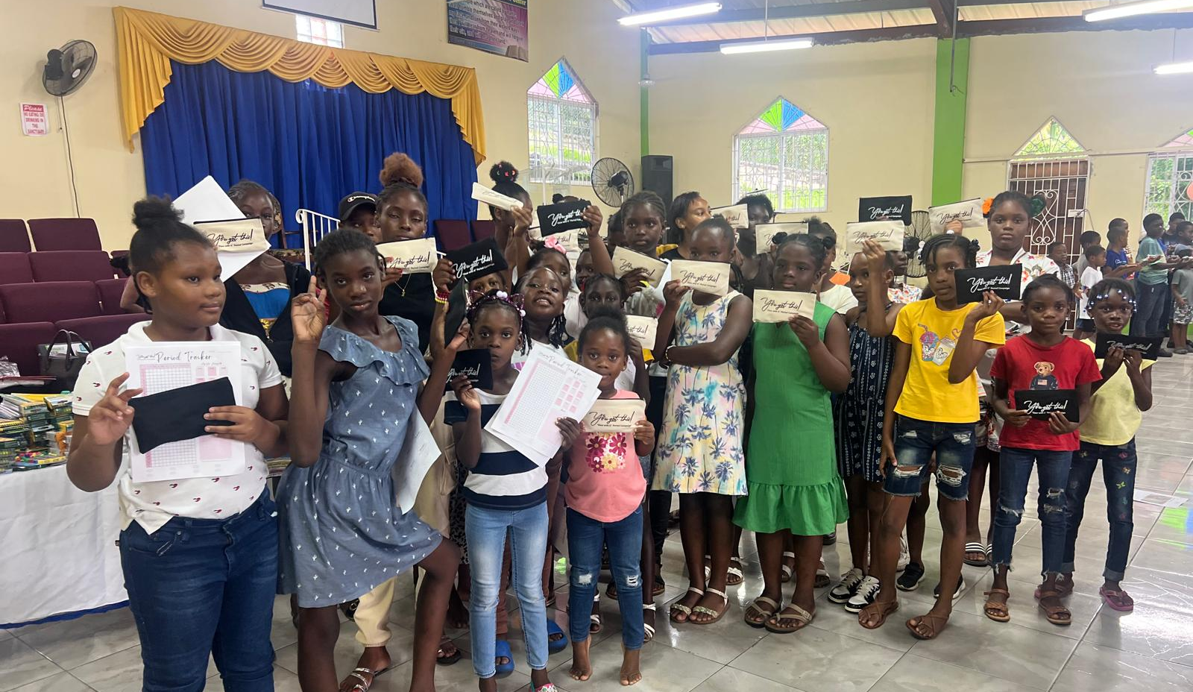
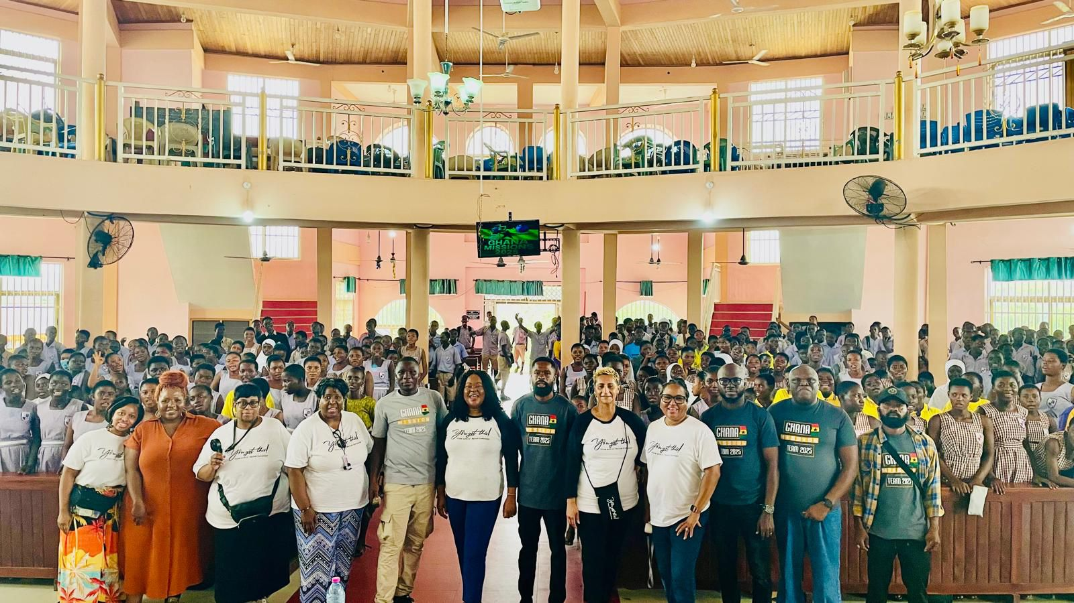
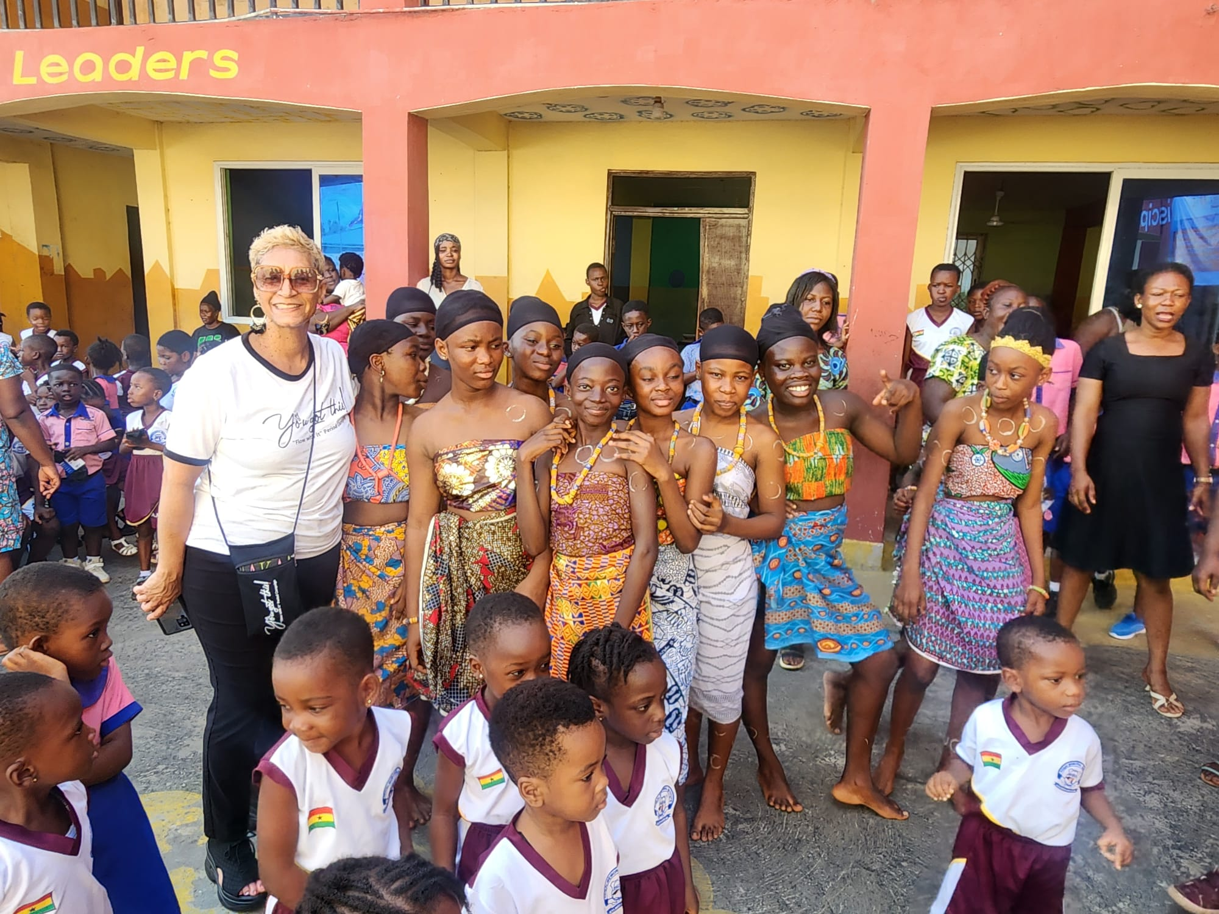

Slide 6
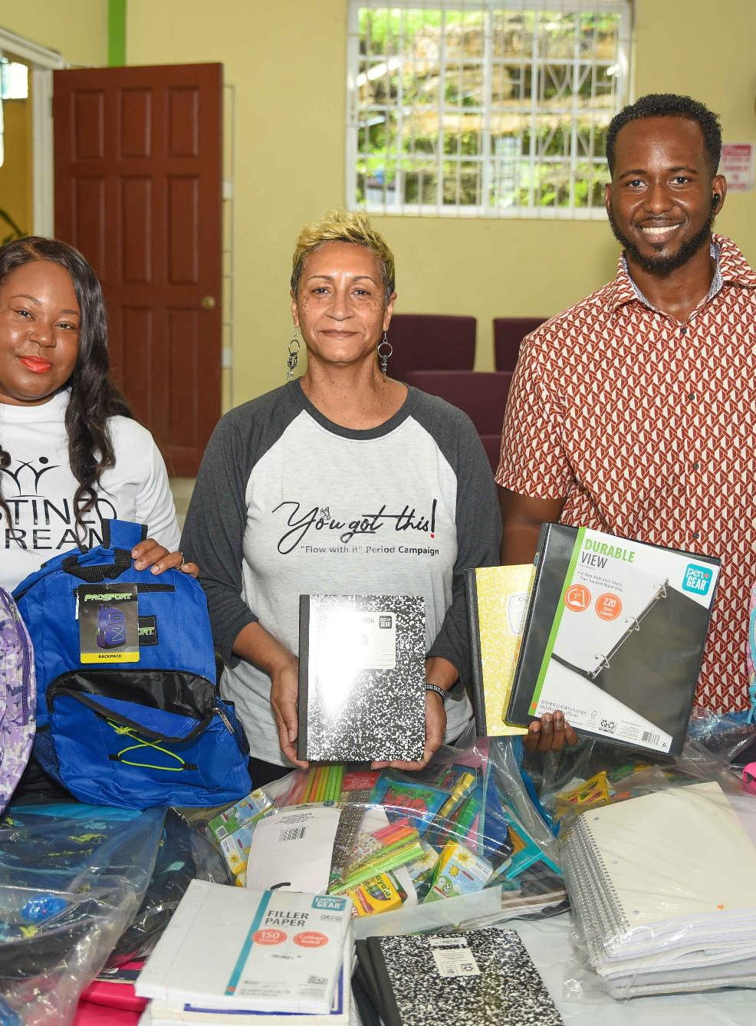

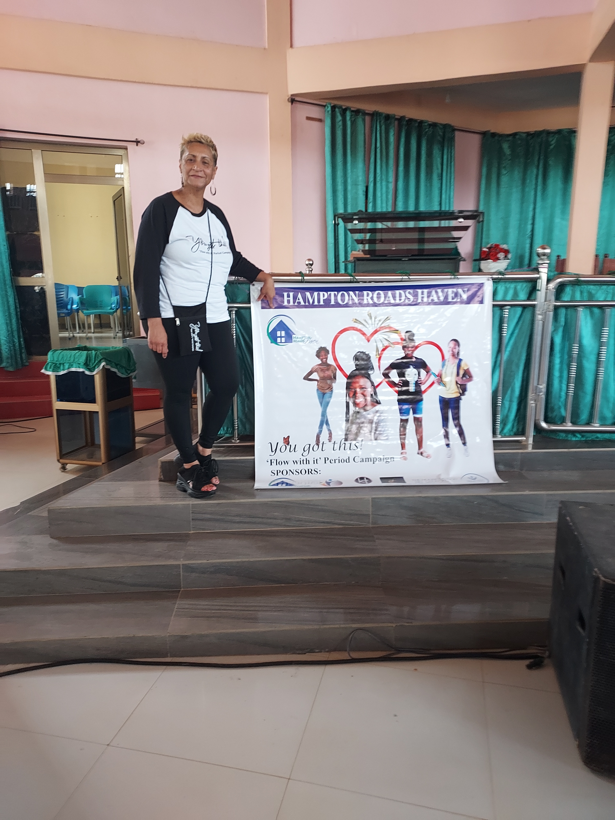
Community Partners
🤝 Hampton Roads Haven: This is one of our service projects along with serving the homeless community.
Destiny Dream Projects: This partnership enables “You Got This! Flow With It!” period campaign to reach underserved communities internationally and locally to create lasting impact.

Slide 7
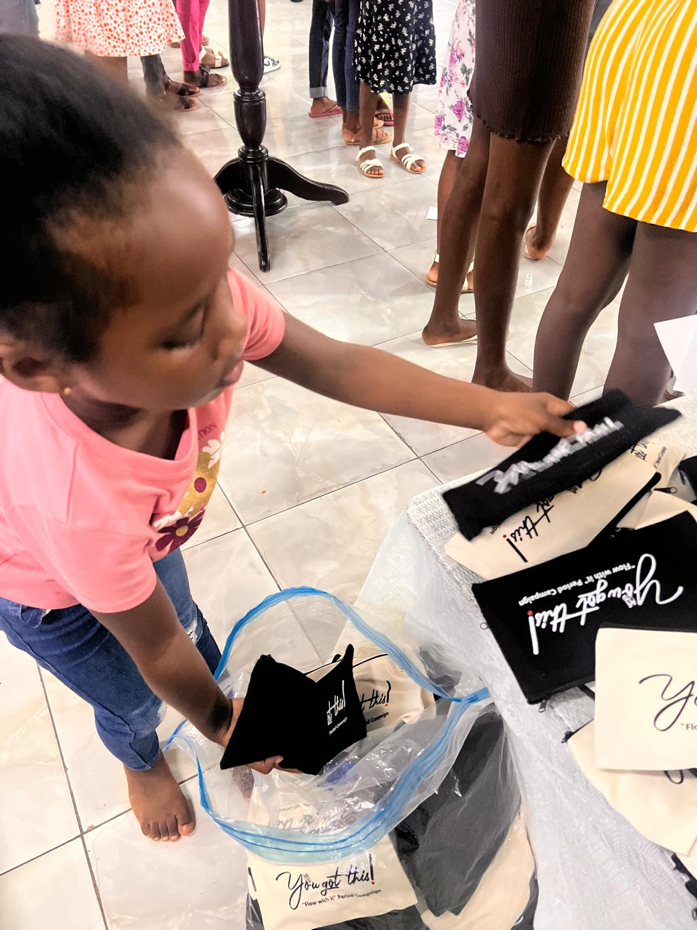
Impact Highlights
✔ Distributed thousands of sanitary pads to girls in Ghana and Jamaica
  Ghana:
    2024: 400+ girls
    2025: Approx. 1000 girls
  Jamaica:
    2024: 100 girls
    2025: 150 girls
✔ Conducted educational workshops on menstrual hygiene
✔ Promoted confidence, self-care, and health awareness
✔ Built global community support networks

Slide 8
Next Steps
2025
Current Outreach in Ghana & Jamaica
2026
Expansion to St. Croix & U.S. Launch – school programs, community partnerships, and advocacy
Ongoing
Product donations, education drives, and awareness campaigns

Slide 9
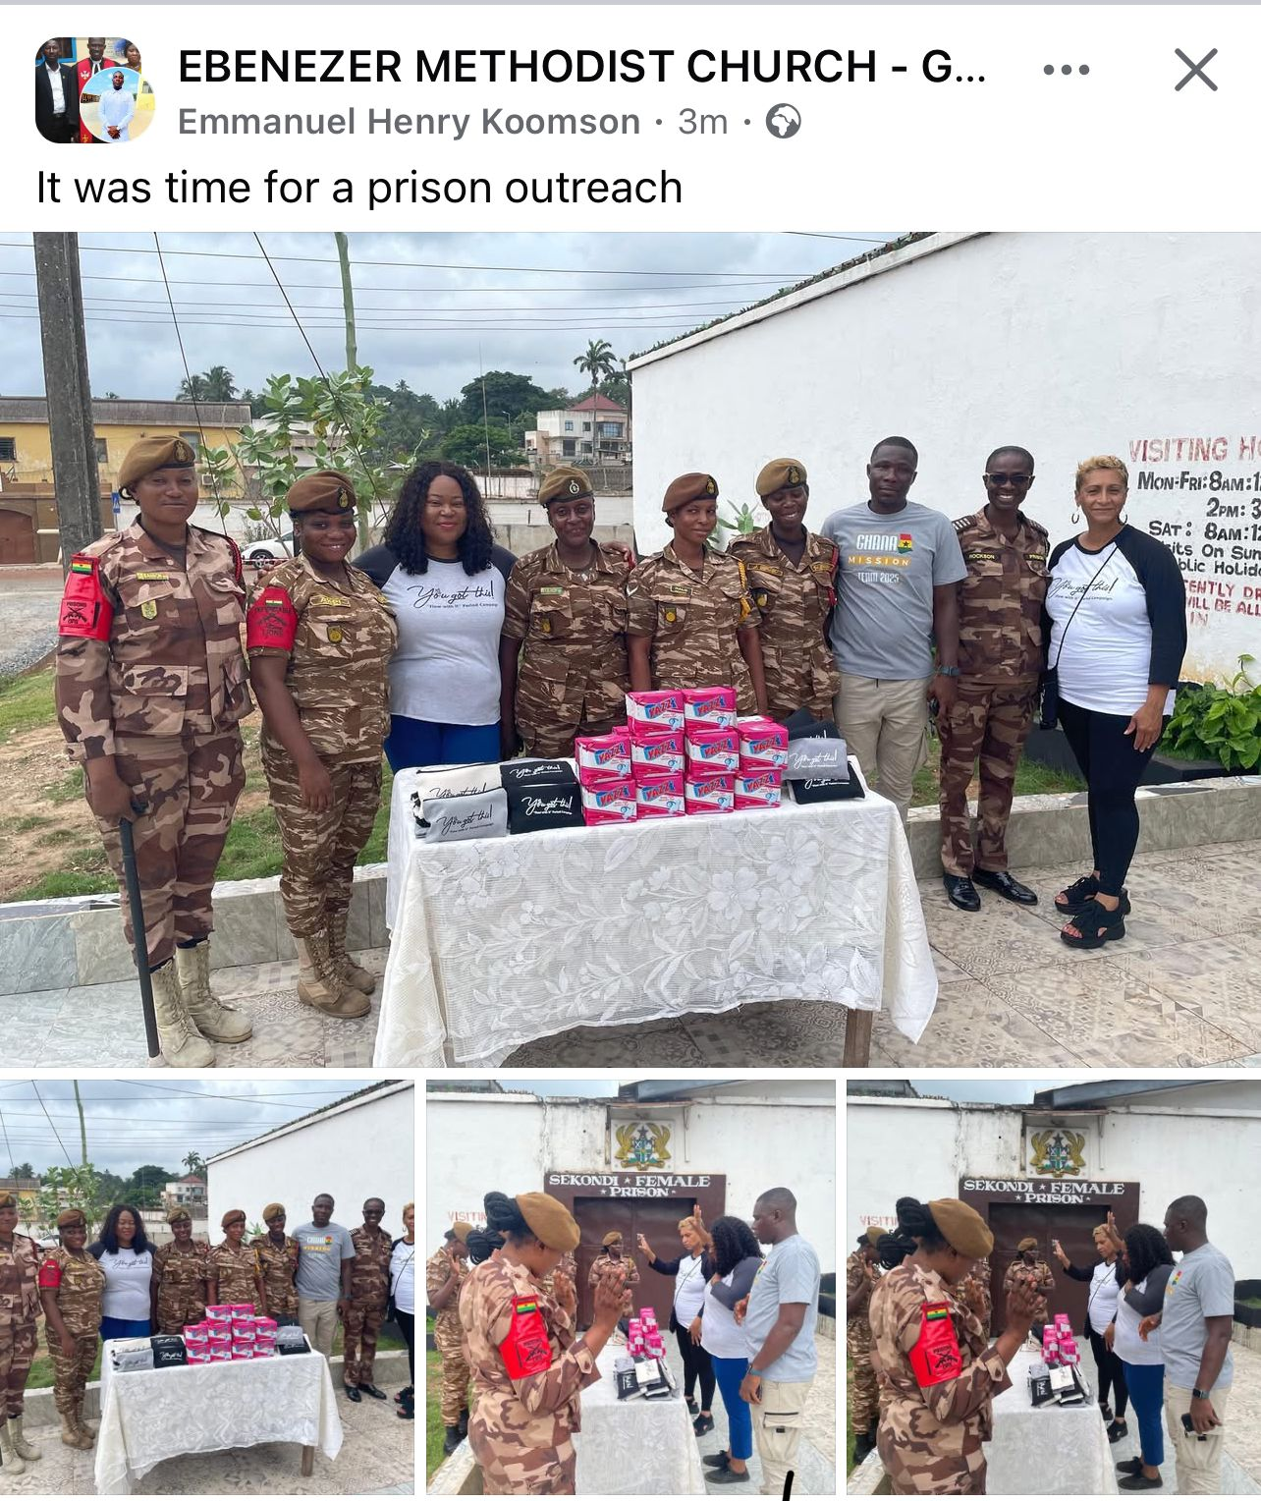
How Can You Help?
🌺 You Got This! Flow With It! — Empower the Flow
Periods shouldn’t stop potential. Your organization can make a direct impact by helping fund essential items that bring empowerment and comfort:
🧳 Suitcases for period supplies ($100–$300 per suitcase): The suitcase(s) will hold the supplies.
🩸 Period Pads ($250): Providing reliable comfort and hygiene for those who need it most.
💼 Period Pouches ($300+): Pouches filled with essential supplies.
🎨 Screenprinting Pouches ($300–$400): Custom empowerment message to inspire confidence.
🧼 Period Wipes ($100+): Promoting hygiene, comfort, and self-care during every cycle.
📅 Period Trackers ($100): Track monthly cycles with confidence and knowledge.
Join us in supporting menstrual equity.
Your contribution helps young people say, “I’ve got this!” — and truly flow with it.

Slide 10
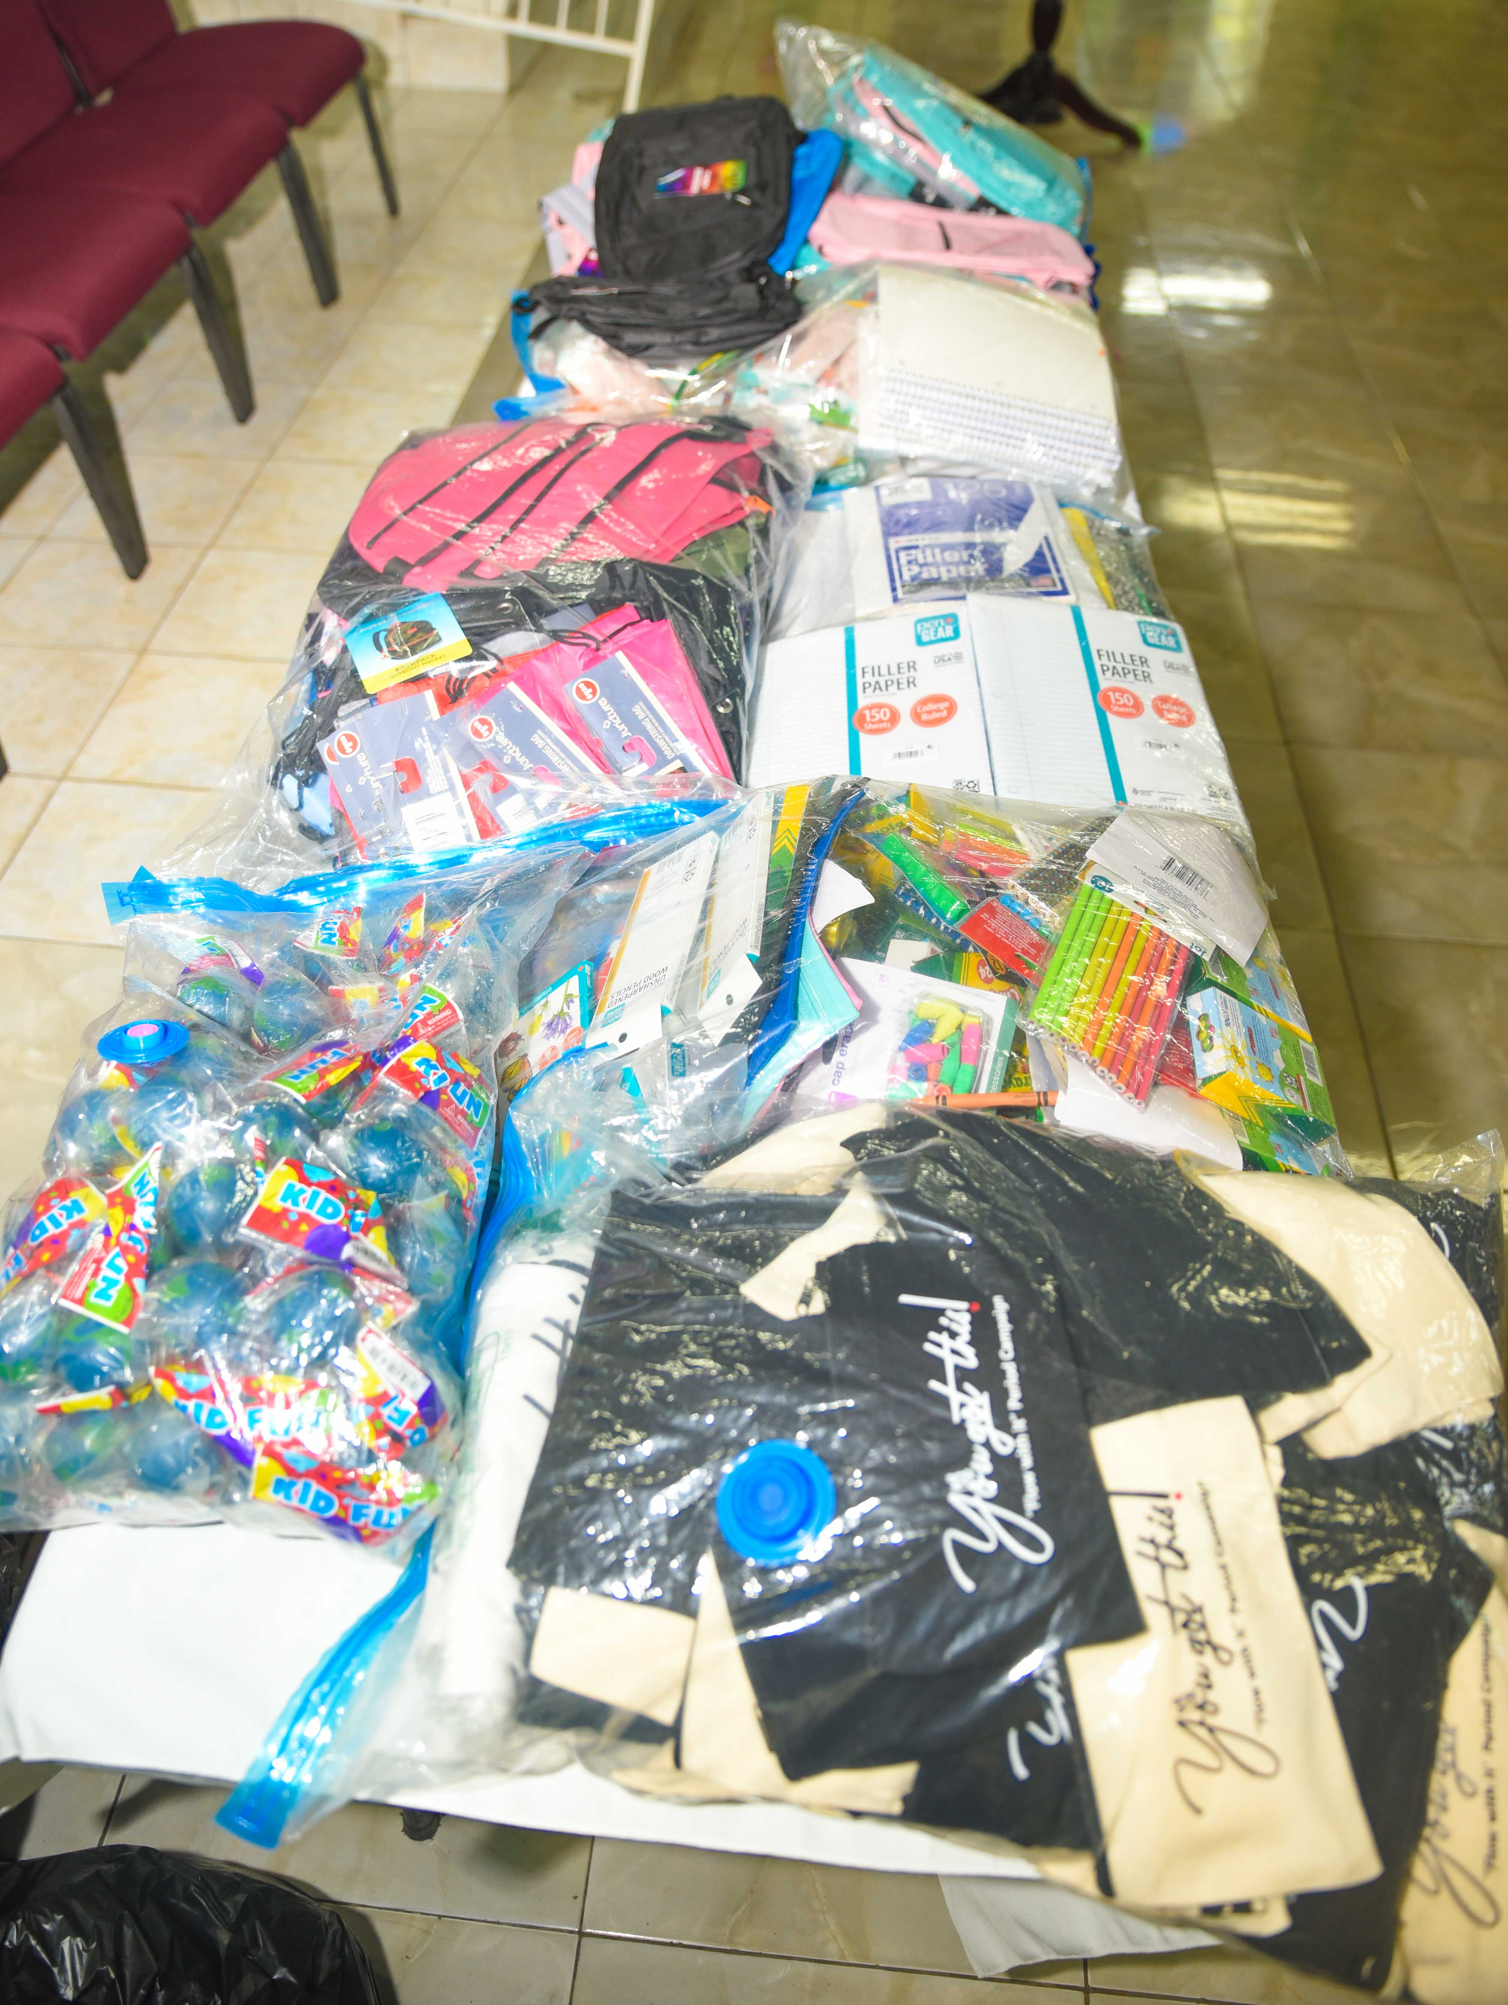
Join the Movement
Together, we can end period poverty, uplift communities, and empower girls to thrive.
Follow and support: 'You Got This! Flow With It!'

